Slide 1


Files and Persistence

Slide 2

Overview
Files
Persistence
Pickles
Shelves
https://docs.python.org/3/library/shelve.html
https://docs.python.org/3/library/pickle.html

Slide 3

Opening Files
OK
Use open() with ‘rt’ to open file and read in text mode
Need to use a relative or absolute path if file in another directory
Closing file at end of operation important to prevent problems
Try/finally block or context manager will automatically close file
# files/open_try.py
da = open('dadams.txt', 'rt') # r: read, t: text
for line in da.readlines():
print(line.strip()) # remove whitespace and print
da.close()
Best way to do it
# files/open_try.py da = open('dadams.txt') # rt is default try: for line in da: # we can iterate directly on da print(line.strip()) finally: da.close()
# files/open_with.py
with open('dadams.txt') as da:
for line in da:
print(line.strip())
Better

Slide 4
Writing files
Print function output redirected to file instead of standard output stream
Input, output, and error streams are represented by the file objects sys.stdin, sys.stdout, and sys.stderr
Opens file, strips whiespace on right-side of each line
Writes to new file with new lines at end each line
# files/print_file.py
with open('print_example.txt', 'w') as fw:
print('Hey I am printing into a file!!!', file=fw)
# files/read_write.py
with open('dadams.txt') as f:
lines = [line.rstrip() for line in f
with open('dadams_copy.txt', 'w') as fw:
fw.write('\n'.join(lines))

Slide 5
Reading Binary files
Binary files could be .zip, bin, jpg, wav
# Specify the size of each chunk to read
chunk_size = 16
with open('ComputerScience64.jpg', 'rb') as file_:
# Using while loop to iterate the file data
while True:
chunk = file_.read(chunk_size)
if not chunk:
break
# Processing the chunk of binary data
print(f'Read {len(chunk)} bytes: {chunk}')
# files/read_write_bin.py
with open('example.bin', 'wb') as fw:
fw.write(b'This is binary data...')
with open('example.bin', 'rb') as f:
print(f.read()) # prints: b'This is binary data...'

Slide 6
Protect against overwriting
The w flag will truncate an existing file
The x flag will only open a file for writing if it doesn’t already exist
# files/write_not_exists.py
with open('write_x.txt', 'x') as fw: # this succeeds
fw.write('Writing line 1')
with open('write_x.txt', 'x') as fw: # this fails
fw.write('Writing line 2')

Slide 7
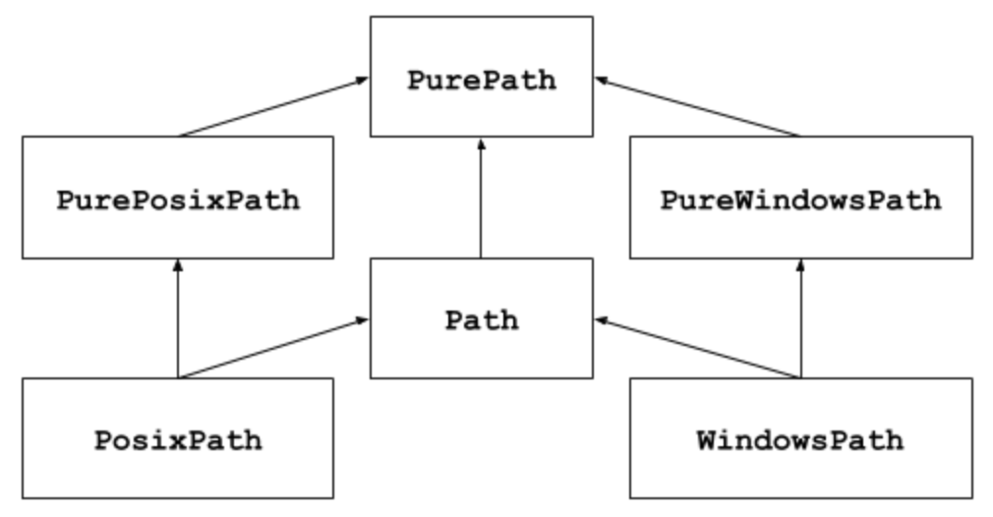
Import pathlib module
Offers classes representing filesystem paths for different operating systems.
Path classes are divided between pure paths
inherit from pure paths but also provide I/O operations.
# files/existence.py
from pathlib import Path
p = Path('fear.txt')
path = p.parent.absolute()
print(p.is_file()) # True
print(path) # /Users/something
print(path.is_dir()) # True
q = Path('/Users/cnavarro/Documents')
print(q.is_dir()) # True

Slide 8

Serialization and Deserialization
Object serialization is the process of converting state of an object into byte stream
Byte stream can be stored in any file-like object such as a disk file or memory stream
Can be transmitted via sockets etc
Deserialization is the process of reconstructing the object from the byte stream.
Can use the __dict__ object when serializing with JSON

Slide 9
Working with JavaScript Object Notation
# json_examples/json_basic.py
import sys
import json
data = {
'big_number': 2 ** 3141,
'max_float': sys.float_info.max,
'a_list': [2, 3, 5, 7],
}
json_data = json.dumps(data)
data_out = json.loads(json_data)
assert data == data_out # json and back, data matches
# test if True, if not, False raises an AssertionError.
print(f'all output: {data_out} \n')
print(json.dumps(data, indent=2, sort_keys=True))
JSON is a standard for data interchange that is compatible with most languages.
Encoding/Decoding is synonymous with serialization
Based on two structures: name/value pairs and and ordered list of values
Maps to dict and list data types

Slide 10
In-memory IO stream
The io.StringIO class provides in-memory stream operations for text input/output using a memory buffer
Data is directed to streams instead of file
Use getvalue() to get context of stream
With provides a context manager that automatically calls close()
# io_examples/string_io.py
import io
with io.StringIO() as stream:
stream.write('Learning Python Programming.\n')
print('Become a Python ninja!', file=stream)
contents = stream.getvalue()
print(contents)

Slide 11
HTTP get requests
python -m pip install requests
Hyper Text Transfer Protocol is the backbone of internet communication
Use the requests library to use get and post calls
Requests library has 30 million downloads a week
Uses a get request to API that responds partially in JSON encoding
The json() method replaces resp.tesxt and json.loads()
# io_examples/reqs.py
import requests
urls = {
"get": "https://httpbin.org/get?t=learn+python+programming",
"headers": "https://httpbin.org/headers",
"ip": "https://httpbin.org/ip",
"user-agent": "https://httpbin.org/user-agent",
"UUID": "https://httpbin.org/uuid",
"JSON": "https://httpbin.org/json",
}
def get_content(title, url):
resp = requests.get(url)
print(f"Response for {title}")
print(resp.json())
for title, url in urls.items():
get_content(title, url)
print("-" * 40)

Slide 12
HTTP post requests
python -m pip install pprint
Get sends data in query string in url window
Post sends data in headers and is more common for web forms to obfuscate data
Post supports binaries
Data is sent in key/value pairs
Uses pretty print library to improve readability
# io_examples/reqs_post.py
import requests, pprint
url = 'https://httpbin.org/post'
data = dict(title='Learn Python Programming')
resp = requests.post(url, data=data)
print('Response for POST')
pprint.pprint(resp.json(),width=-1)

Slide 13

Python pickle
# persistence/pickler.py
import pickle
from dataclasses import dataclass
@dataclass
class Person:
first_name: str
last_name: str
id: int
def greet(self):
print(f'Hi, I am {self.first_name} {self.last_name}'
f' and my ID is {self.id}')
people = [
Person('Obi-Wan', 'Kenobi', 123),
Person('Anakin', 'Skywalker', 456),
]
# save data in binary format to a file
with open('data.pickle', 'wb') as stream:
pickle.dump(people, stream)
# load data from a file
with open('data.pickle', 'rb') as stream:
peeps = pickle.load(stream)
for person in peeps:
person.greet()
The pickle module implements binary protocols for serializing and de-serializing a Python object structure.
“Pickling” is the process whereby a Python object hierarchy is converted into a byte stream, and “unpickling” is the inverse operation
Also known as serialization or flattening
Example uses @dataclass decorator
Save to a file by using pickle.dump to feed content to be pickled, and stream to write
Only unpickle data you trust.

Slide 14
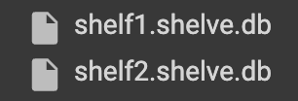
Python shelve
# persistence/shelf.py
import shelve
class Person:
def __init__(self, name, id):
self.name = name
self.id = id
with shelve.open('shelf1.shelve') as db:
db['obi1'] = Person('Obi-Wan', 123)
db['ani'] = Person('Anakin', 456)
db['a_list'] = [2, 3, 5]
db['delete_me'] = 'we will have to delete this’
print(list(db.keys())) # 'ani', 'delete_me’, …
del db['delete_me'] # gone!
print(list(db.keys())) # ['ani', 'a_list', 'obi1']
print('delete_me' in db) # False
print('ani' in db) # True
a_list = db['a_list']
a_list.append(7)
db['a_list'] = a_list
print(db['a_list']) # [2, 3, 5, 7]
A “shelve” is a persistent, dictionary-like object.
Difference with “dbm” databases is that the values (not the keys!) in a shelf can be arbitrary Python object
Anything that the pickle module can handle, shelf can handle
Used instead of a relational type database
To delete data stored at a key, we need to open a file using open() and then use “del”.

